Slide 1


DESIGN AND MODELLING OF FOOTWEAR FOR VISUALLY IMPAIRED
PROJECT MEMBERS:
V.SRIRAM 20700398
R.SIRANJEEVEE 20700397
G.VARUN 20700400
J.C.KUBER 20700373
V.VENKAT CHARAN 20700401
YASHWANTHA SAI G.K 20700406
GUIDE: Mrs S.P.CHITRA (HOD)

Slide 2
ABSTRACT
This project focuses on developing smart shoes for the visually impaired persons.
The smart shoe has embedded ultrasound sensors on the toe to warn blind users of obstacles in their path.
It can detect potential obstacles located up to four meters in front of the user.
The wearer is warned with the help of vibration motor.

Slide 3
In order to increase the charge retention of the battery, the force exerted during walking is converted to electrical energy to charge the battery This is done using a piezoelectric disc.
The built-in batteries effortlessly cope with average daily life, due to this intelligent control system and battery charge lasts for a week.
The shoe is designed mechanically and components are selected in a way, so as to keep it small, Lightweight, simple and comfortable.

Slide 4
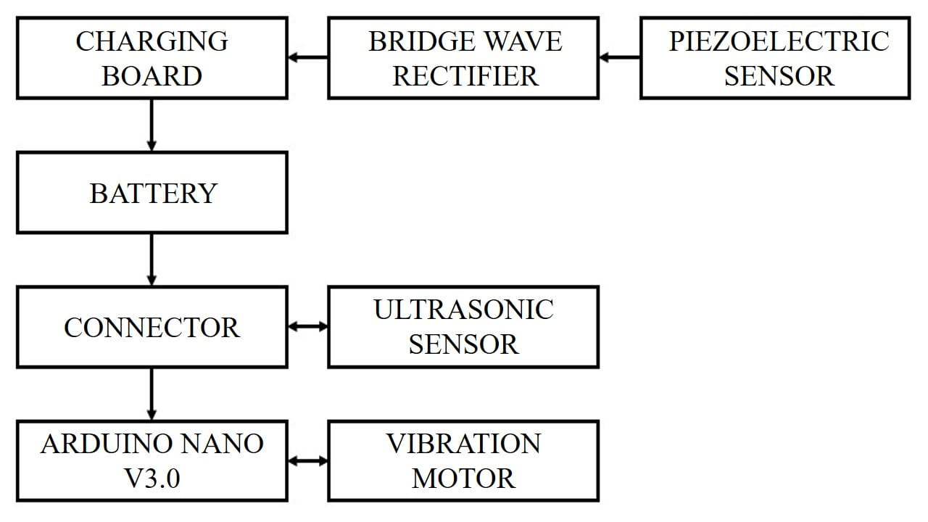
BLOCK DIAGRAM

Slide 5
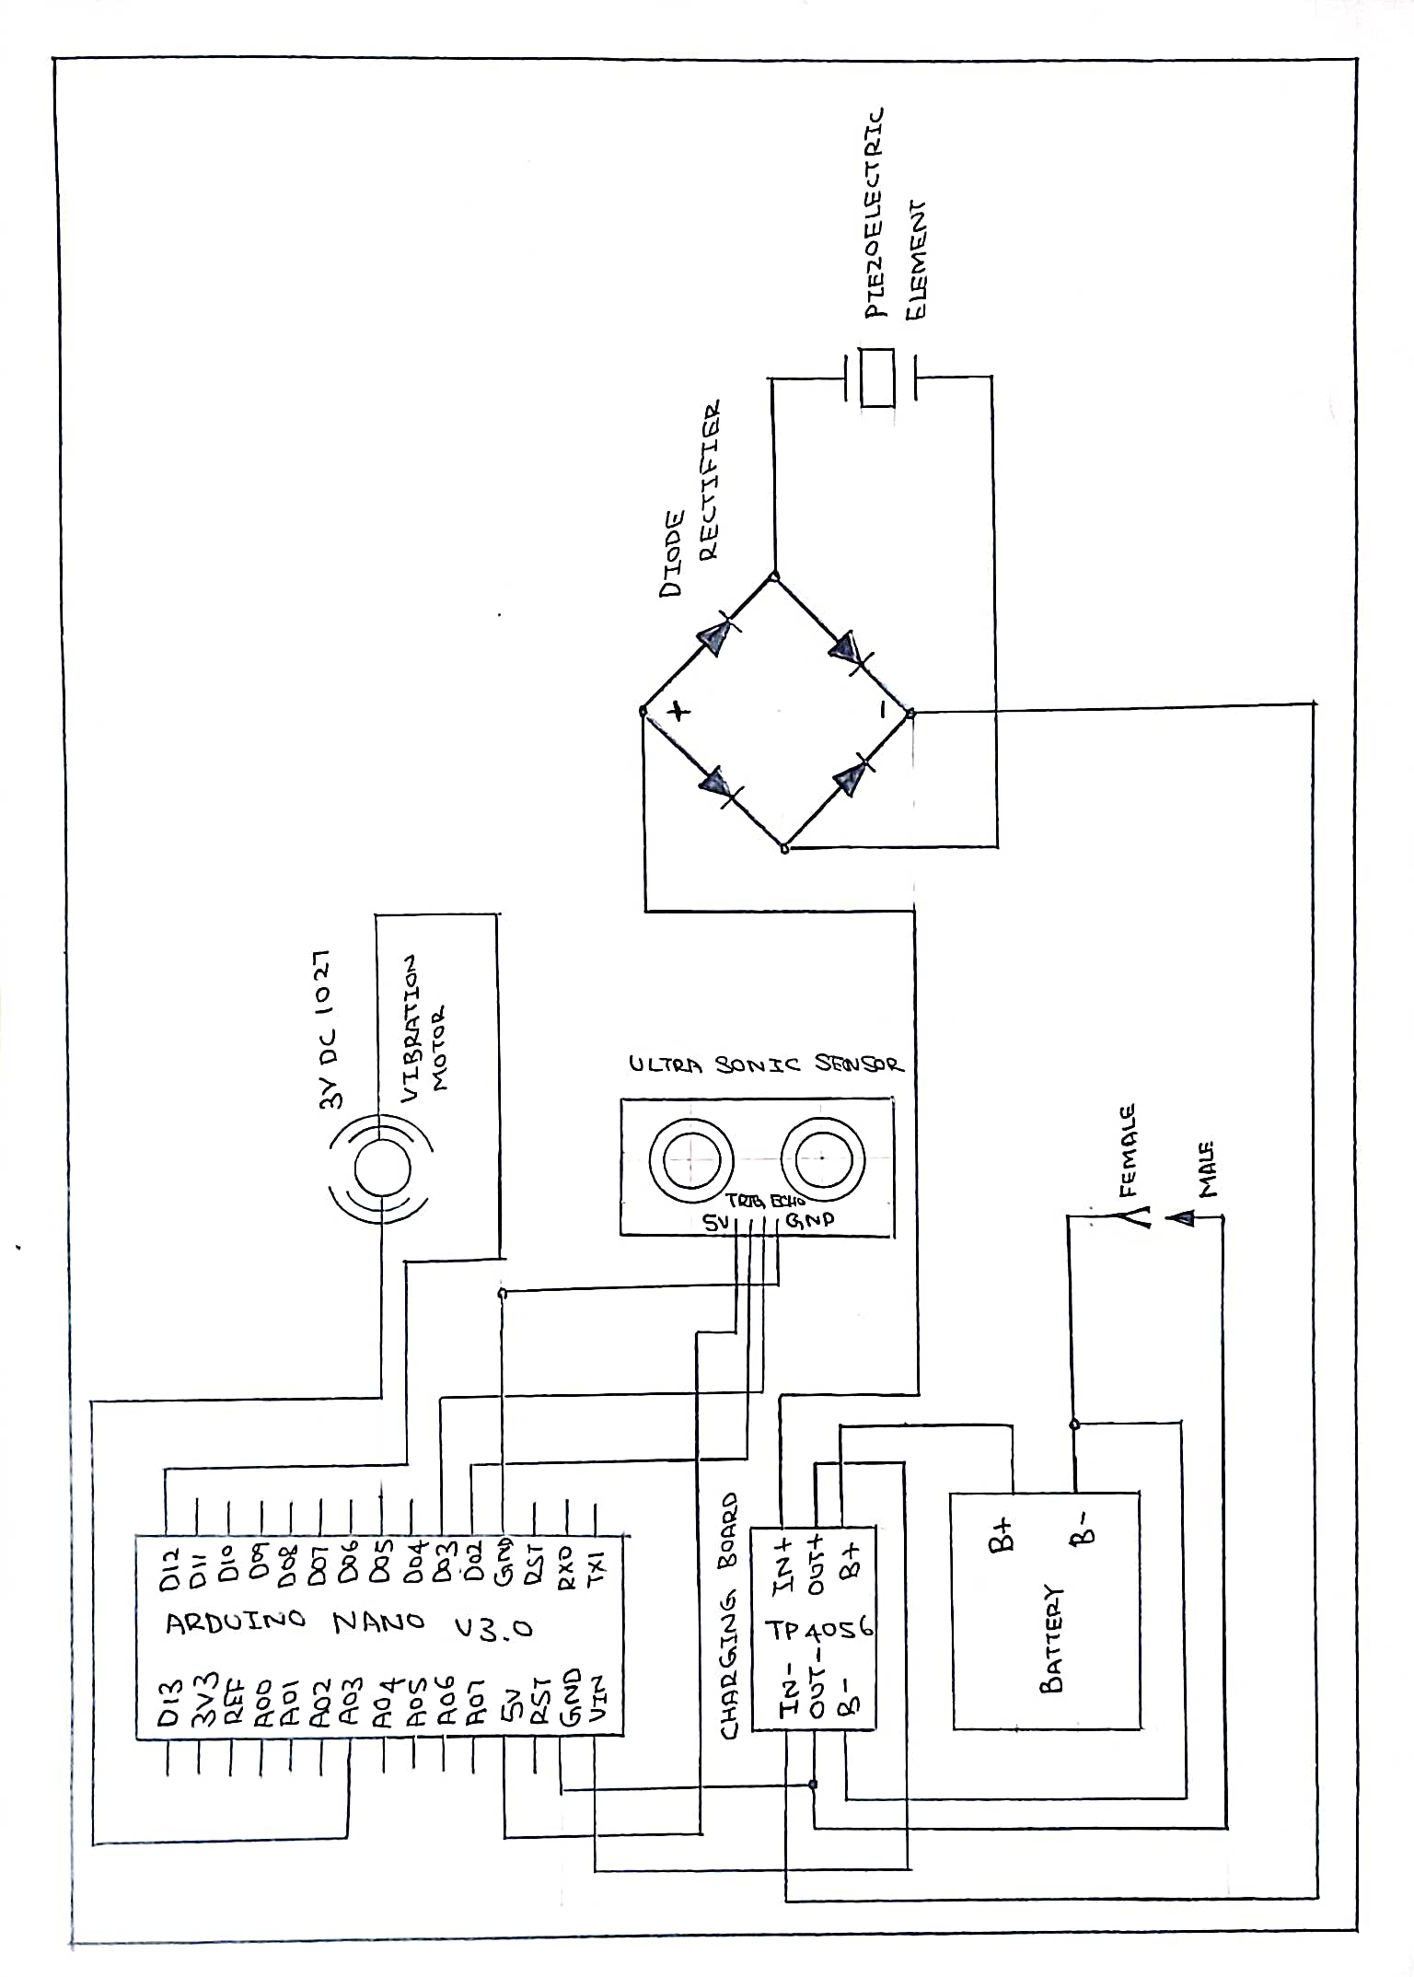
CIRCUIT DIAGRAM

Slide 6
COMPONENTS PURCHASED
NAME | SPECIFICATIONS
Charging Board | 3V DC TP 4056
Arduino NANO Atmega 328p/CH340 | V3.0
Battery | 3.7 V 1050mAh
Vibration Motor | 3V DC 1027
Ultrasonic Sensor | HC-SR04
Bridge Wave Rectifier | 1N4007
Piezo Electric Disk | -

Slide 7
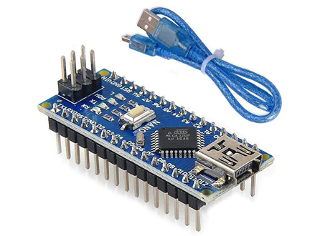
ARDUINO NANO
The Arduino Nano is a small, complete, and breadboard-friendly board based on the ATmega328p/CH340 (Arduino Nano v3.0).
It offers the same connectivity and specs of the Arduino UNO board in a smaller form factor
It lacks only a DC power jack, and works with a Mini-B USB cable instead of a standard one.

Slide 8
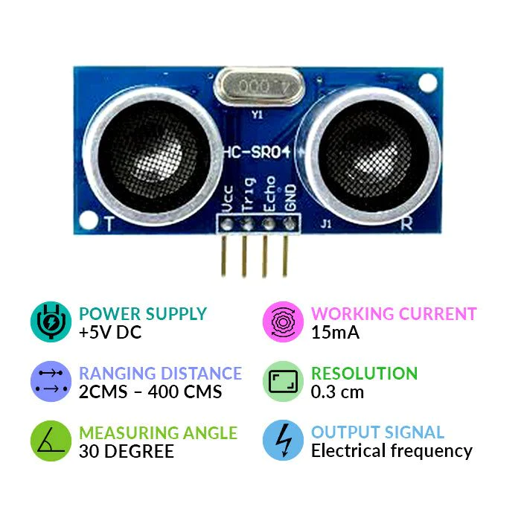
ULTRASONIC SENSOR
An ultrasonic sensor is an electronic device that measures the distance of a target object by emitting ultrasonic sound waves, and converts the reflected sound into an electrical signal.
Ultrasonic sensors have two main components: the transmitter (which emits the sound using piezoelectric crystals) and the receiver (which encounters the sound after it has travelled to and from the target).

Slide 9
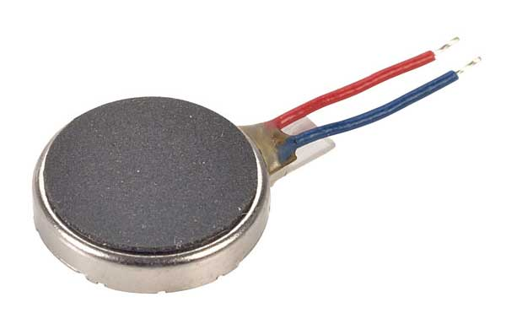
VIBRATION MOTOR
Vibration motor is a compact size coreless DC motor used to informs the users of receiving the signal by vibrating, no sound.
Vibration motors are widely used in a variety of applications including cell phones, handsets, pagers, and so on.

Slide 10
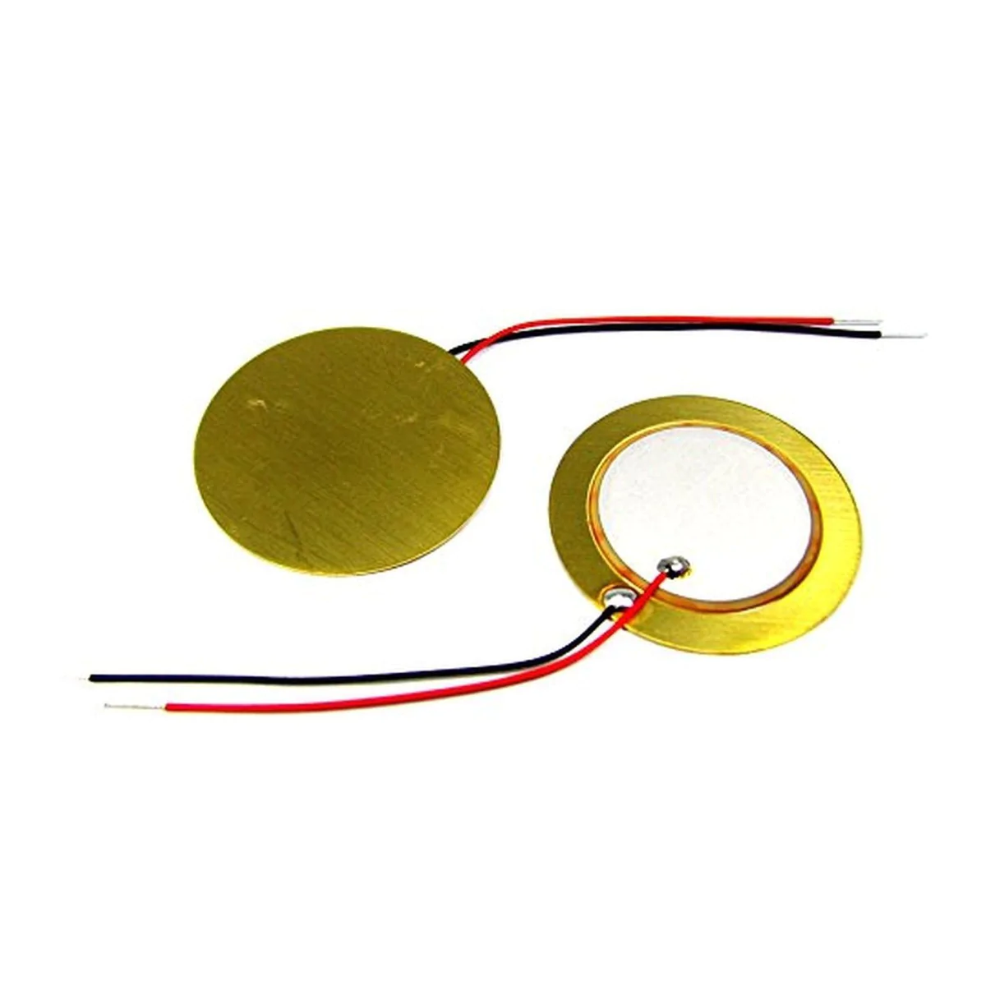
PIEZO ELECTRIC DISC
A piezoelectric ceramic disc that converts electrical energy to mechanical energy is known as a piezo actuators.
When voltage is applied to the piezo ceramic disc, the piezoelectric material contracts or expands, deforming the piezo disc actuator and generating displacement.

Slide 11
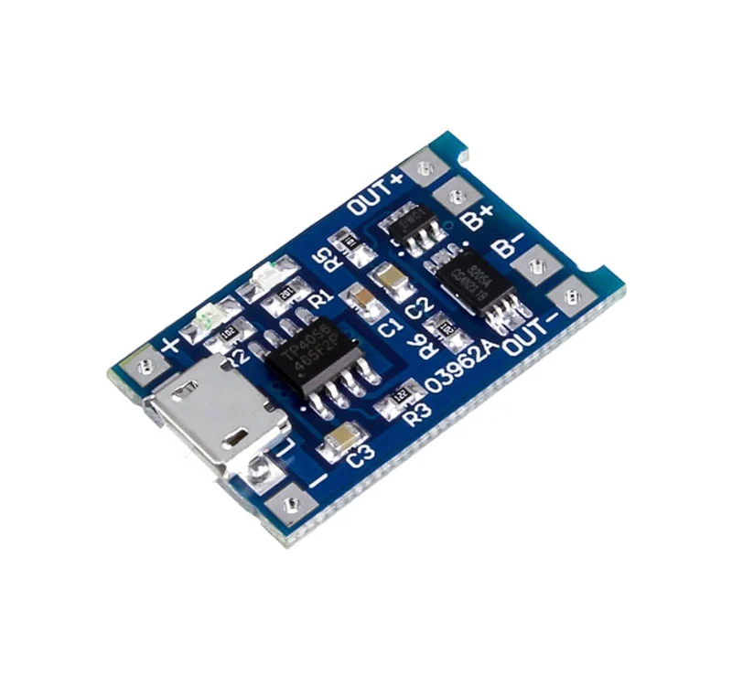
CHARGING BOARD
TP4056 1A Li-ion lithium Battery Charging Module – Mini USB
A full charge voltage: 4.2V. Power: 4.2 w. Charging accuracy: 1.5%. Operating Temperature: -10 to +85ºC. Charging indicator: Blue LED charging, Red LED full.

Slide 12
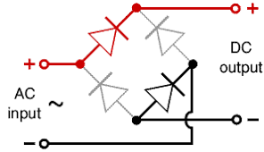
BRIDGE WAVE RETIFIER
1N4007 is a rectifier diode, designed specifically for circuits that need to convert alternating current to direct current.
It can pass currents of up to 1 A, and have a peak inverse voltage (PIV) rating of 1,000 V. Characteristics: Maximum Recurrent Peak Reverse Voltage 1000V.

Slide 13
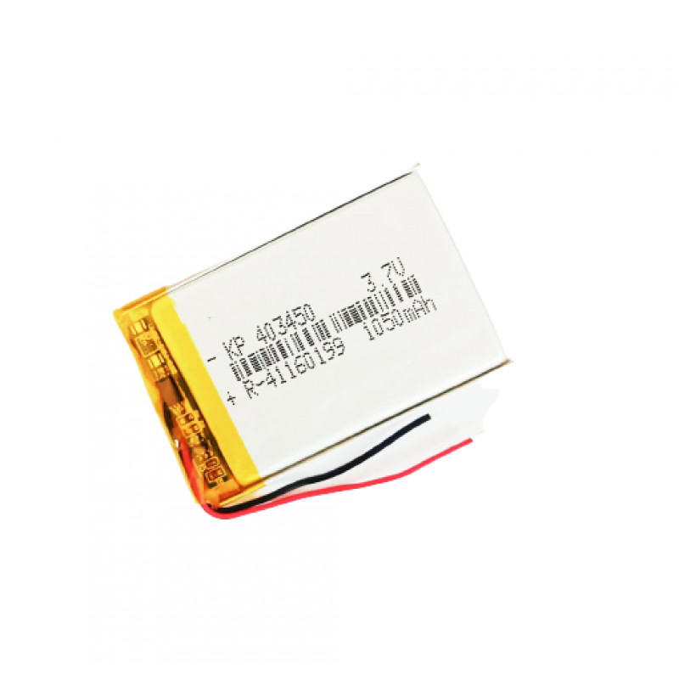
BATTERY
A battery is a device that converts chemical energy contained within its active materials directly into electric energy by means of an electrochemical oxidation-reduction (redox) reaction.
This type of reaction involves the transfer of electrons from one material to another via an electric circuit

Slide 14
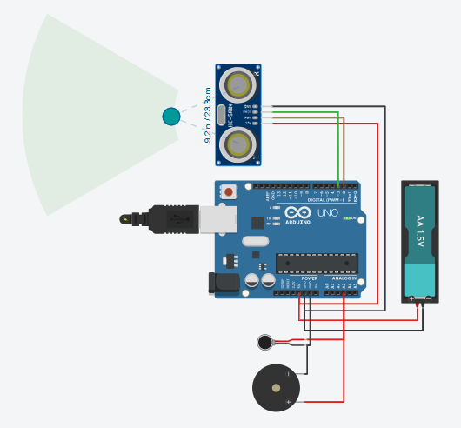
SIMULATION DIAGRAM

Slide 15
ARDUINO NANO PROGRAM
PROGRAMMING:
/*Modified by
* Blue and Black Flame Master, BBFM15
*/
#define pingPin 2 //trig pin of sr04
#define echoPin 3
void setup()
{
Serial.begin(9600); // Starting Serial Terminal
pinMode(pingPin,OUTPUT);
pinMode(echoPin,INPUT);
pinMode(12,OUTPUT); //pin12 is used as GND pin for motor since arduino nano has only two GND pins
pinMode(A3,OUTPUT); //pin A3 provides the output on motor
}
void loop()
{
long duration, cm;
digitalWrite(12, LOW); //motor GND is always low

Slide 16
//send a signal at ping pin at an interval of 0.002 seconds to check for an object
digitalWrite(pingPin, LOW);
delayMicroseconds(2);
digitalWrite(pingPin, HIGH);
delayMicroseconds(10);
digitalWrite(pingPin, LOW);
duration = pulseIn(echoPin, HIGH); //check time using pulseIn function
cm = microsecondsToCentimeters(duration); //functin call to find distance
/* Serial.print(cm);
Serial.print("cm");
Serial.println();
delay(100);
for debugging
*/
if (cm<30&&cm>20)
{analogWrite(A3,255);
delay(1000);
analogWrite(A3,0);
delay(1000); } //vibration motor every 0.10second if obstacle distance is between 20-30cm.

Slide 17
else if (cm<20&&cm>10) {analogWrite(A3,255);
delay(500);
analogWrite(A3,0);
delay(500); } //vibration motor every 0.5 seconds if obstacle distance is between 10-20cm.
else if (cm<10&&cm>0) {analogWrite(A3,255);
delay(100);
analogWrite(A3,0);
delay(100); } //vibration motor every 0.01 seconds if obstacle distance is between 0-10cm.
else analogWrite(A3,0); //do not sound the motor
}
//function to return distance in cm from microseconds
long microsecondsToCentimeters(long microseconds)
{
return microseconds / 29 / 2;
}

Slide 18
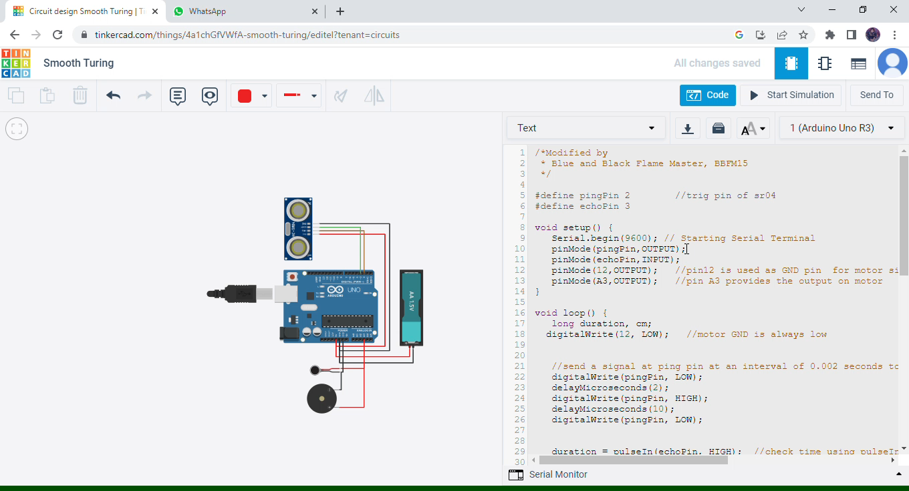
SIMULATION VIDEO

Slide 19
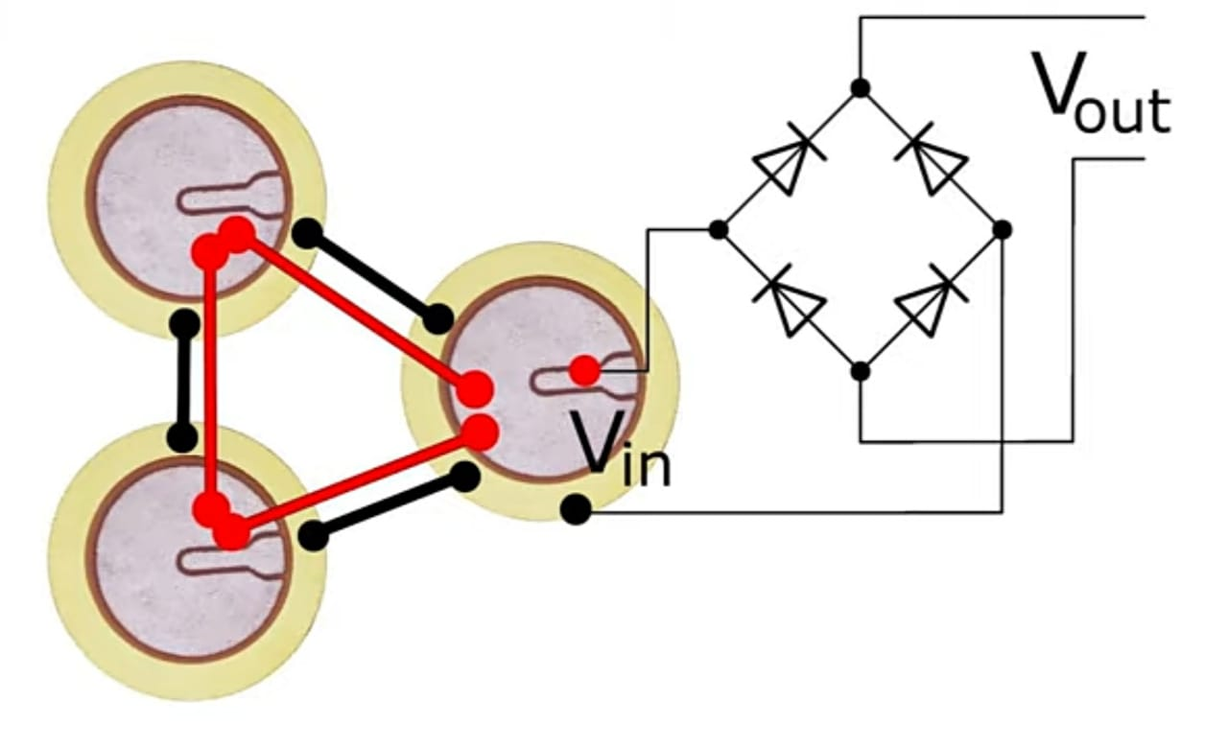
PIEZO DISC CONNECTED TO BRIDGE WAVE RETIFIER CONNECTED

Slide 20
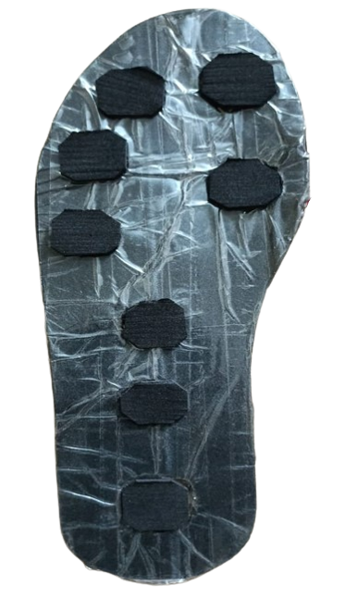
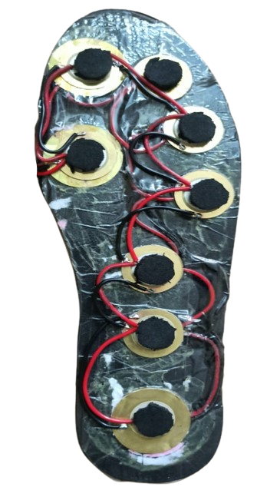
PIEZO DISK ATTACHED TO BOTH SOLES OF THE SHOES
TOP SIDE OF THE SOLE
BOTTOM SIDE OF THE SOLE
7.776 V PER DAY IS PRODUCED BY BOTH THE SOLES COMBINED FOR DAILY USAGE
THE CURRENT PRODUCED IN TOP SOLE IS 64.8mA
THE CURRENT PRODUCED IN BOTTOM SOLE IS 66mA

Slide 21
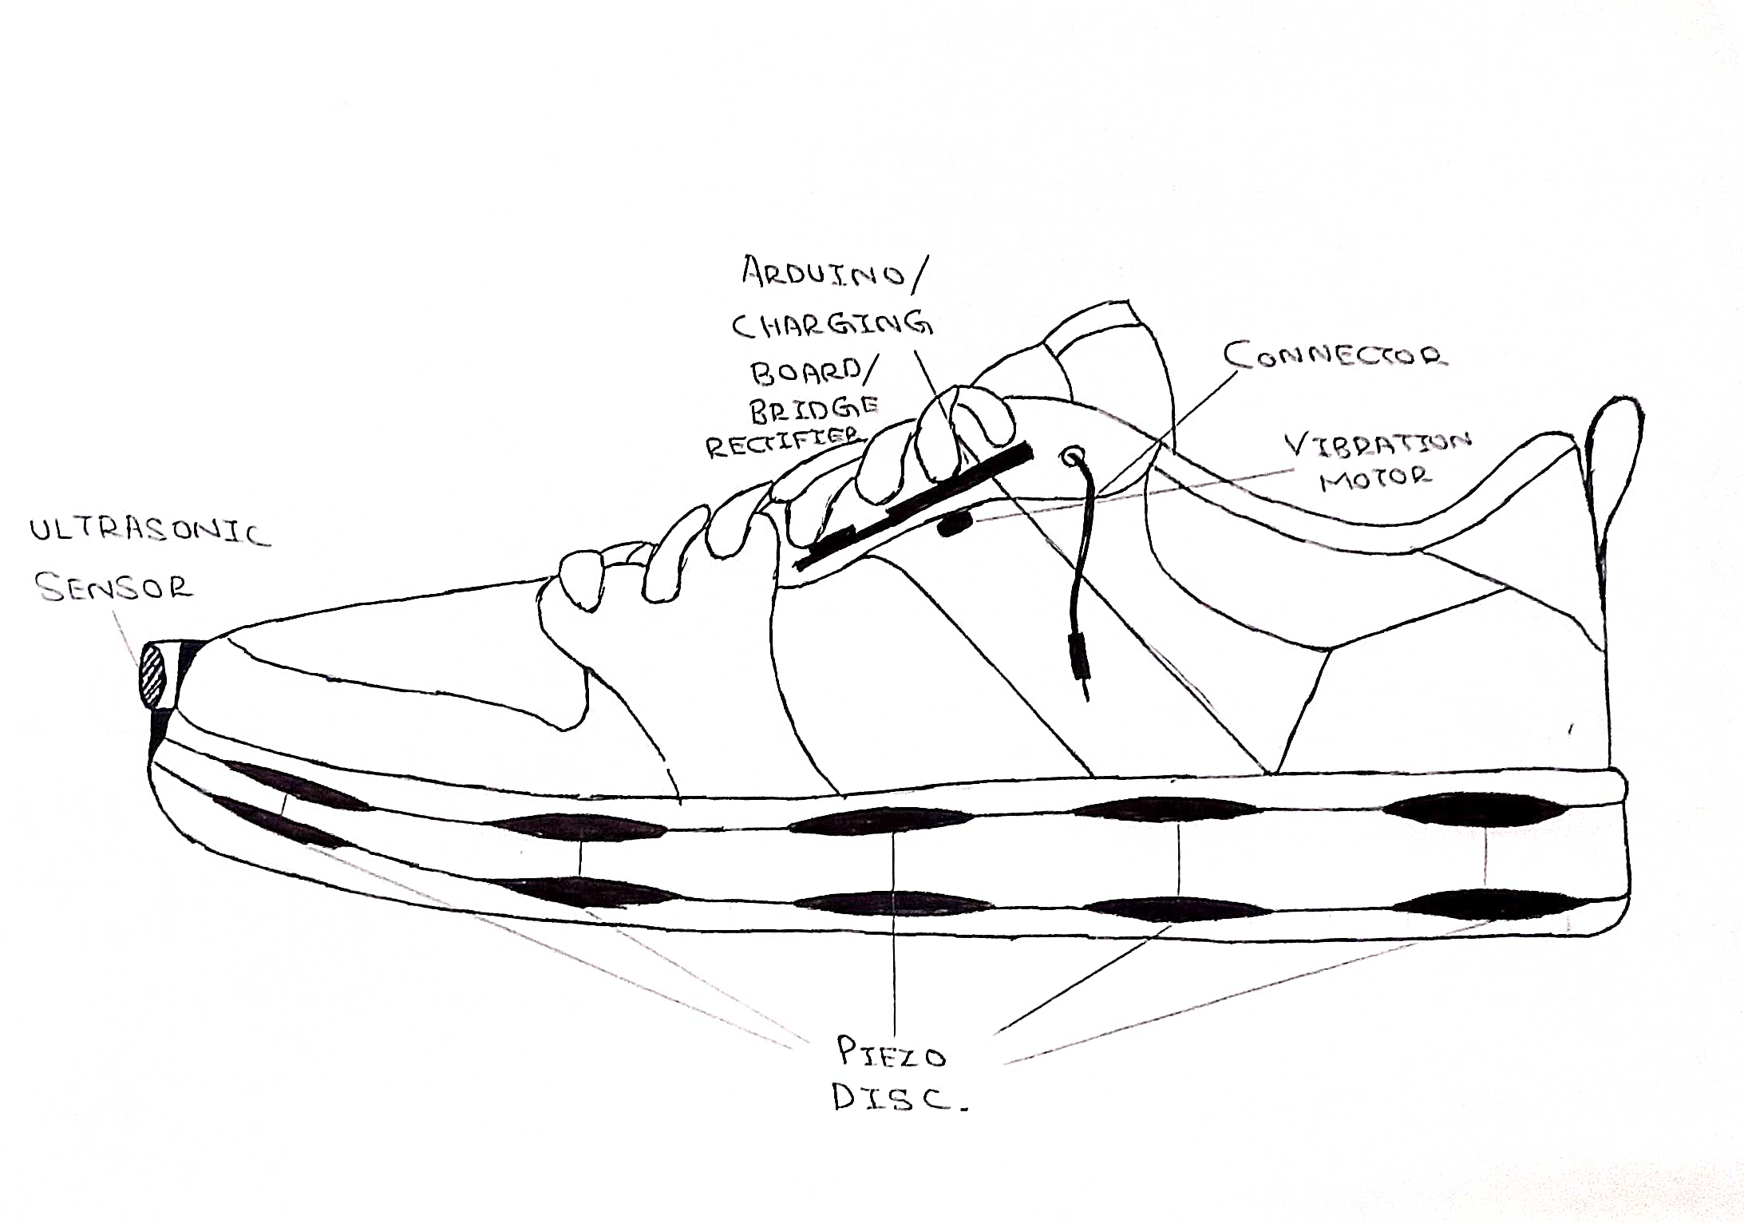
FINALISED SHOE SKETCH

Slide 22
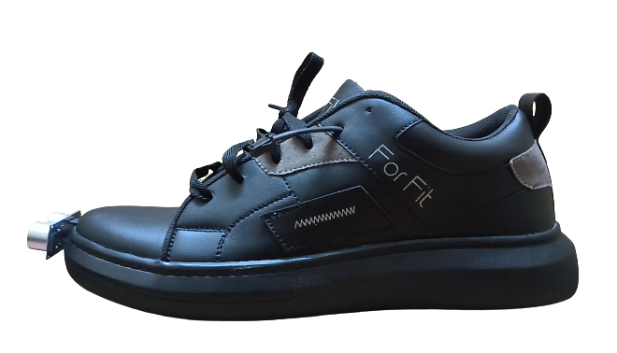
FINALYSIED MODEL

Slide 23
CONCLUSION
This project can be improved by adding Bluetooth connectivity and can be paired by using Bluetooth headset and give information using headset and may also can be attached camera and use python to detect objects.

Slide 24
Thank you

Slide 25


